Slide 1


Image Forgery Detection using Deep Learning
Aldel Education Trust’s
St. John College of Engineering and Management, Palghar
NAAC Accredited with Grade A+
Department of Information Technology
Yash Kamble [EU1214003]
Aditya Pandey [EU1214021]
Bhavesh Kumavat [EU1214047]
Mr. Manthan Surti | Project Guide
April 7th, 2025
1

Slide 2
Contents
Abstract
Introduction
Literature Review
Research Gap
Problem Statement
Methodology
System Architecture
Technology Stack
Implementation
Algorithm/Flowchart
Conclusion
References
2

Slide 3
Abstract
In the digital age, the proliferation of advanced image editing tools has made it increasingly easy to manipulate visual media. This poses significant challenges in various domains such as journalism, law enforcement, and social media, where the authenticity of images is paramount. Traditional methods of detecting image forgery are often manual, time-consuming, and prone to human error. As a result, there is a growing need for automated solutions that can accurately detect image manipulations and ensure the integrity of visual content.
The primary challenge is to develop a robust system that can detect image forgery with high accuracy and efficiency. Existing techniques struggle with various types of manipulations such as splicing, copy-move forgery, and deepfakes. Moreover, the scalability of these solutions to handle large volumes of images in real-time remains an issue. There is a critical need for an advanced, scalable, and automated method to detect and verify the authenticity of images.
This project will develop a machine learning-based system to detect image forgeries by analyzing inconsistencies in pixel patterns and compression artifacts. The solution will integrate multiple detection algorithms to provide a unified integrity score for each image, enhancing accuracy and reliability. It will be trained on a comprehensive dataset of authentic and manipulated images to recognize various forgery techniques. The end goal is to deliver a scalable, efficient, and user-friendly tool for ensuring the authenticity of visual content.
3

Slide 4
Introduction
Motivation:
In an era where digital media plays a critical role in shaping public opinion, information dissemination, and legal evidence, the authenticity of visual content is more important than ever. With the increasing availability of sophisticated image editing tools, the threat of manipulated media—whether through simple alterations or advanced techniques like deepfakes—has grown significantly. This manipulation can lead to misinformation, loss of public trust, and serious consequences for individuals, organizations, and society at large.
The motivation for this project stems from the urgent need to develop an automated, scalable, and reliable system for detecting image forgeries. By utilizing machine learning, we aim to create a solution that not only enhances the accuracy and speed of forgery detection but also helps in maintaining the integrity of visual content. This project seeks to contribute to the broader effort of combating digital disinformation and ensuring that images, which are often used as evidence or trusted sources of information, remain authentic and credible.
3

Slide 5
Introduction
Objective:
Develop a robust and automated image forgery detection system using machine learning techniques.
Accurately detect various types of image manipulations, including splicing, copy-move forgeries, and deepfakes.
Ensure scalability and efficiency for processing and analyzing large volumes of images in real-time.
Train machine learning models on a diverse dataset of authentic and manipulated images for real-world applicability.
Create a user-friendly interface accessible to non-technical users in journalism, law enforcement, and social media.
Contribute to the fight against digital misinformation by ensuring the integrity of visual content.
3

Slide 6
Introduction
Scope:
The scope of this project encompasses the development of an image forgery detection system using machine learning to identify and detect manipulated images. The project involves collecting and preprocessing a large dataset of both authentic and manipulated images, followed by designing and training machine learning models capable of identifying forgeries. Ensuring real-time scalability is a key focus, enabling the system to process large volumes of images efficiently. This system can be applied across multiple domains where the authenticity of visual content is crucial. In journalism, it can help verify the authenticity of images before publication, preventing the spread of manipulated news. In law enforcement, the system can assist in analyzing photographic evidence to ensure its integrity in investigations and court proceedings. For social media platforms, the system can be integrated to detect and flag manipulated images, helping reduce the dissemination of false information. Moreover, it can be used in digital forensics, media organizations, and academic research to safeguard the authenticity of visual data. By developing a user-friendly interface, the project ensures that users from various fields can easily access and benefit from the tool.
3

Slide 7
Literature Review
Sr.no | Paper Title (ref) | Author’s Name(s) | Conclusion | Advantages | Research Gap
1 | Modeling of Reptile Search Algorithm With Deep Learning Approach for Copy Move Image Forgery Detection [2023] | Mashael Maashi Hayam Alamro Heba Mohsen Noha Negm | RSADTL-CMFD uses NASNet, RSA, and XGBoost for CM region detection, showing improved results. Future work involves hybrid DL methods. | High Accuracy Efficient Feature Extraction Optimized Hyperparameters | Complexity Resource Intensive Dependency on pre-trained models
2 | A Survey on Image Forgery Detection Using Different Techniques [2020] | Akram Hatem Saber Mohd Ayyub Khan Basim Galeb Mejbel | The survey highlighted the need for robust, efficient detection methods, noting trade-offs in complexity, accuracy, and robustness among techniques. | High accuracy High visual quality Superior tamper detection Increased detection accuracy | High complexity High false positives Heavy compression Poor robustness
3 | Deep Learning-Based Digital Image Forgery Detection System [2022] | Emad Ul Haq Qazi Tanveer Zia Abdulrazaq Almorjan | Deep learning approach using ResNet50v2 and YOLO CNN achieved 99.30% accuracy on CASIA datasets for image forgery detection. | High Accuracy Transfer Learning State-of-the-art Methods | Dependency on Large Database. Computationally Intensive Specificity to Splicing
4 | Image Region Forgery Detection: A Deep Learning Approach [2016] | Ying Zhang Jonathan Goh Lei Lei Win Vrizlynn Thing | Deep learning approach achieved 91.09% accuracy in detecting tampered images; future work involves DCT input and exploring new architectures. | Format Independence High Accuracy Contextual Information | Training Complexity Imbalanced Data Limited to Patch Level Analysis.
8

Slide 8
Literature Review
Sr.no | Paper Title (ref) | Author’s Name(s) | Conclusion | Advantages | Research Gap
5 | Image Forgery Detection [2009] | Hany Farid | The paper surveys various image forgery detection techniques, categorizing them into pixel-based, format-based, camera-based, physically-based, and geometry-based methods. | Comprehensive Categorization Application to Different Scenarios Advancement in Forensics Tools | Evolving Manipulation Techniques Forensic Tool Efficacy Lack of Standardization
6 | An Analysis of Image Forgery Detection Techniques [2019] | Chandandeep Kaur Navdeep Kanwal | The paper reviews passive forgery detection methods and highlights the challenges of differentiating forgery types. It emphasizes the need for effective solutions due to the ease of digital manipulation. | Comprehensive Review Dataset Coverage Identification of Forgery Types | Human Intervention Specificity of Methods Distinguishing Malicious vs. Innocent Retouching Potential of AI
7 | The Effect of Error Level Analysis on Image Forgery Detection Using Deep Learning [2019] | Wina Permana Sari Hisyam Fahmi | The paper finds that using Error Level Analysis (ELA) as a preprocessing step can enhance deep learning-based forgery detection but is dependent on dataset quality and model. | Combines Traditional and Modern Techniques Improved Detection of Subtle Forgeries Potential for Automation | Dataset Quality Model Optimization ELA Limitation in Complex Forgeries
8 | Detecting Image Forgery over Social Media Using U-NET with Grasshopper Optimization [2023] | Niousha Ghannad Kalpdrum Passi | The paper presents an enhanced U-Net optimized with Grasshopper Optimization Algorithm (GOA) for better image forgery detection on social media, showing improved accuracy on the CASIA dataset. | Improved Accuracy Real-Time Usability Versatility Enhanced Model Architecture | Generalization Across Datasets Handling Complex Forgeries Resource Efficiency
8

Slide 9
Research Gap
While existing methods for image forgery detection have made progress, they often fall short in several key areas. Traditional techniques are primarily manual, making them time-consuming and error-prone, and lack the ability to handle large-scale, real-time analysis of digital images. Current automated systems struggle to detect more advanced manipulations, such as deepfakes and subtle alterations, and their accuracy decreases significantly when dealing with diverse types of forgeries. Additionally, many existing solutions are not sufficiently scalable to meet the demands of high-volume image content across various platforms. There is also limited research on integrating multiple detection techniques to provide a unified, reliable integrity score that can guide decision-making more effectively. Addressing these gaps will require innovative approaches that utilize machine learning models to improve accuracy, scalability, and efficiency in real-world applications.
5

Slide 10
Problem Statement
In today's digital era, the widespread availability of sophisticated image editing tools has made it alarmingly easy to manipulate visual media, posing significant threats to the authenticity of images used in journalism, law enforcement, social media, and other critical domains. These manipulations, ranging from simple alterations to complex forgeries like deepfakes, can have severe implications, including the spread of misinformation, erosion of public trust, and potential harm to individuals and institutions.
Traditional methods for detecting image forgery are often inadequate, being manual, time-consuming, and prone to human error. Moreover, they lack the scalability needed to analyze the vast amounts of visual content generated daily. Existing automated solutions are limited in their ability to accurately detect diverse types of manipulations and often struggle with real-time processing.
There is a pressing need for a robust, scalable, and automated solution that can accurately detect and verify the authenticity of images in real-time. Such a system must leverage advanced machine learning techniques to analyze pixel patterns, compression artifacts, and other anomalies, providing a comprehensive integrity assessment of visual content. This will not only help in preventing the spread of misinformation but also in ensuring the integrity and trustworthiness of visual media across various platforms.
5

Slide 11
Methodology
In this project, both Convolutional Neural Networks (CNN) and Error Level Analysis (ELA) are utilized to create a comprehensive image forgery detection system. CNNs, known for their powerful image processing capabilities, automatically extract features from images by analyzing pixel patterns, textures, and other subtle inconsistencies that are often indicative of manipulation. By passing images through multiple convolutional layers, the CNN learns to recognize intricate forgeries, such as irregular pixel distributions, compression artifacts, or unnatural blending that are often undetectable to the human eye.
ELA, on the other hand, plays a crucial role by highlighting areas of the image that have different error levels in compression, which is a strong indicator of potential edits or manipulations. Authentic images exhibit consistent compression rates, while forged sections show discrepancies, allowing ELA to pinpoint areas of interest. These regions are then fed into the CNN, enabling the model to focus on potentially tampered areas. By combining CNN’s deep learning capability with ELA’s precise identification of manipulated zones, the system achieves a high level of accuracy in detecting various types of image forgeries. This synergy ensures that even the most subtle alterations can be identified effectively.
5

Slide 12
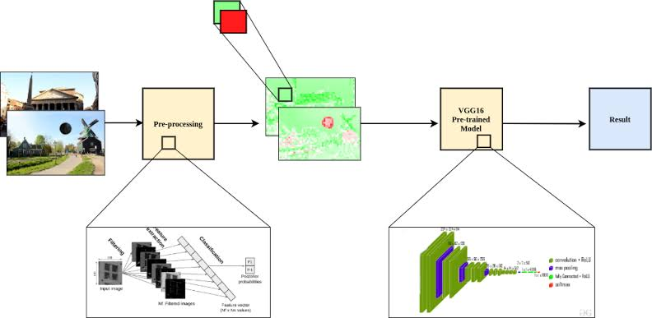
System Architecture
Fig. 1: Block Diagram
10

Slide 13
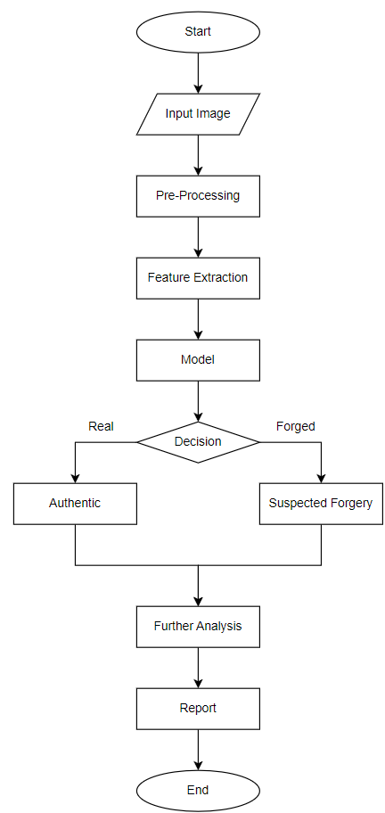
System Architecture
Fig. 2: Flowchart
11

Slide 14
Technology Stack
Hardware Requirements:
1 gigahertz (GHz) or faster 32-bit (x86) or 64-bit (x64) processor.
1 gigabyte (GB) RAM (32-bit) / 2 GB RAM (64-bit).
1 GB available disk space (32-bit) / 20 GB (64-bit).
DirectX 9 graphics processor with WDDM 1.0 or higher driver.
Software Requirements:
Google Colab
Different libraries
Dataset: The dataset in the form of images
Languages used:
Python
14

Slide 15
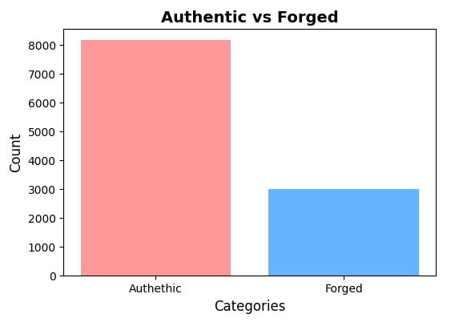
Implementation
Fig. 3: Authentic and Forged Images
14

Slide 16
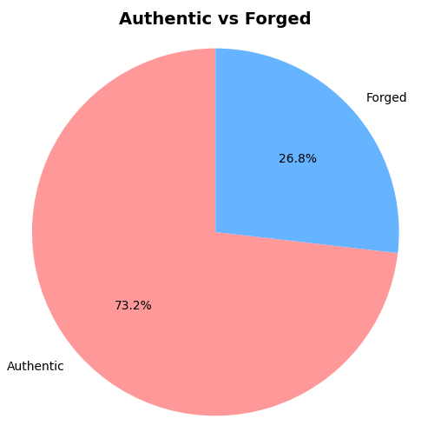
Implementation
Fig. 4: Authentic and Forged Images
14

Slide 17
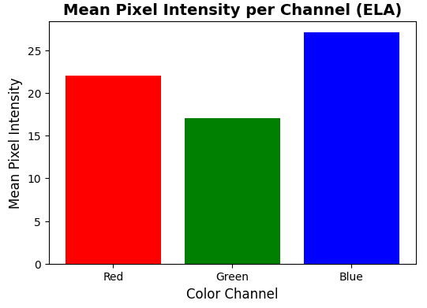
Implementation
Fig. 5: Mean Pixel Intensity per Channel (ELA)
14

Slide 18
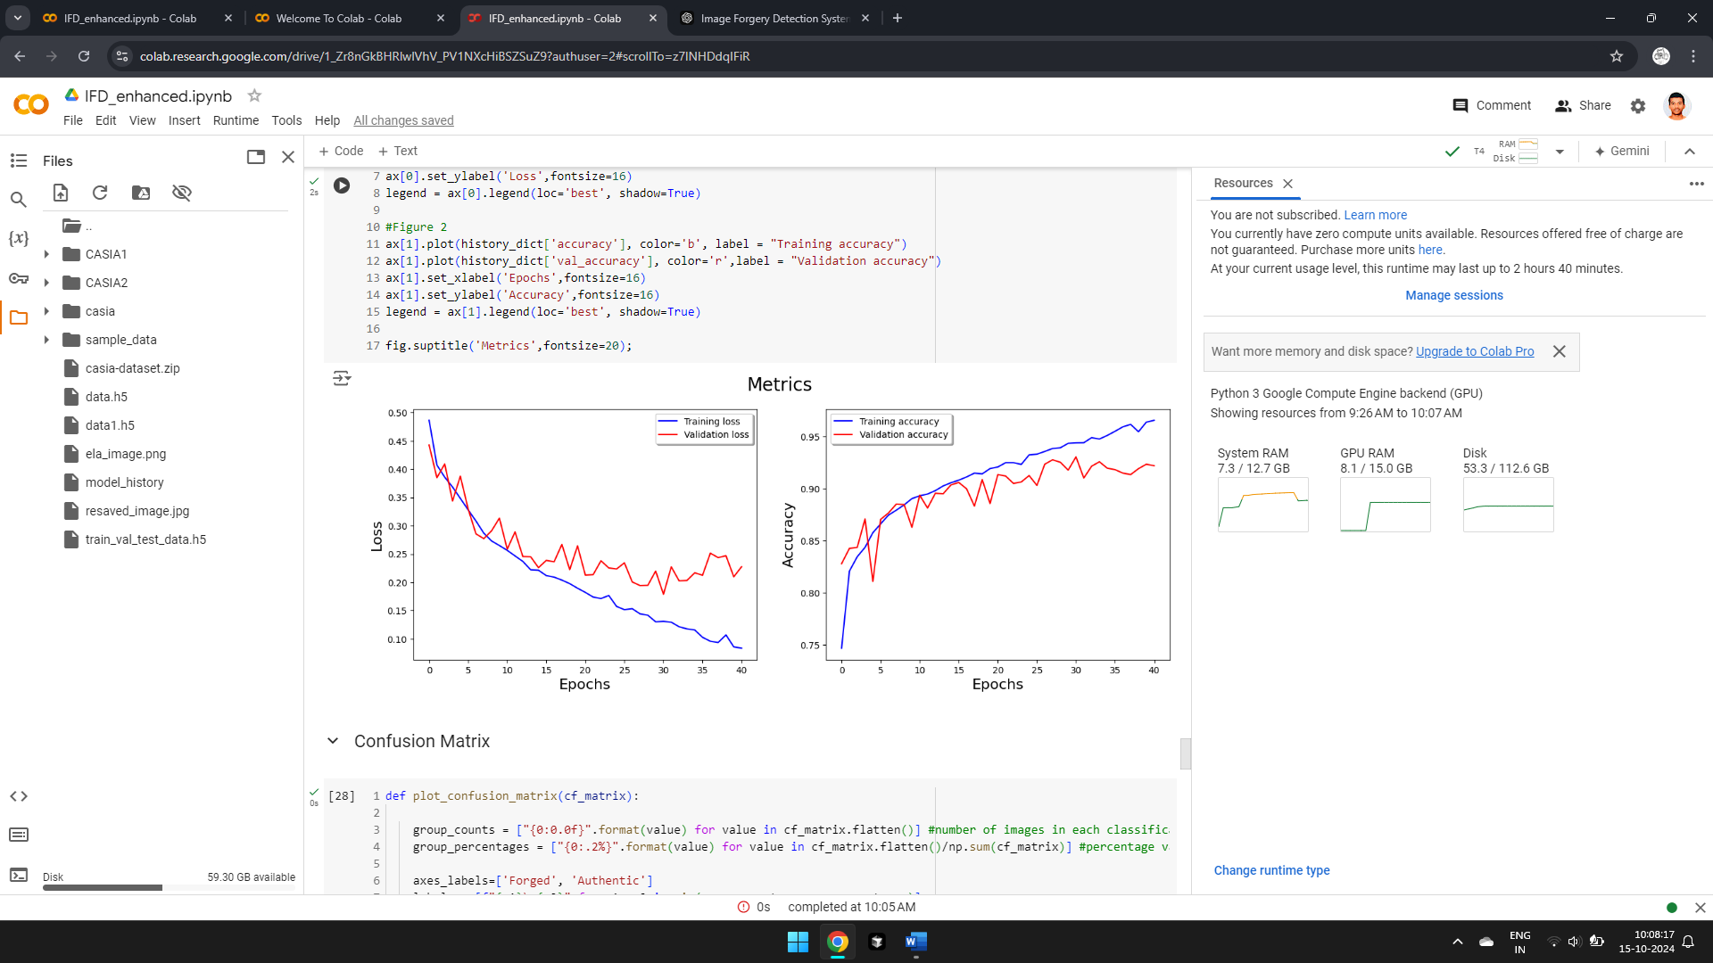
Implementation
Fig. 6: Model Training Metrics (Accuracy over Epochs)
14

Slide 19
Implementation
Fig. 7: Model Training Metrics (Accuracy over Epochs)
14

Slide 20
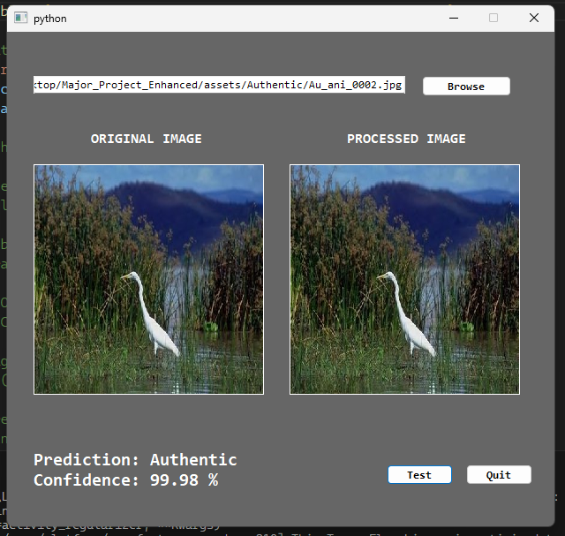
Implementation
Fig. 8: GUI for Image Forgery Detection using ELA (Authentic)
14

Slide 21
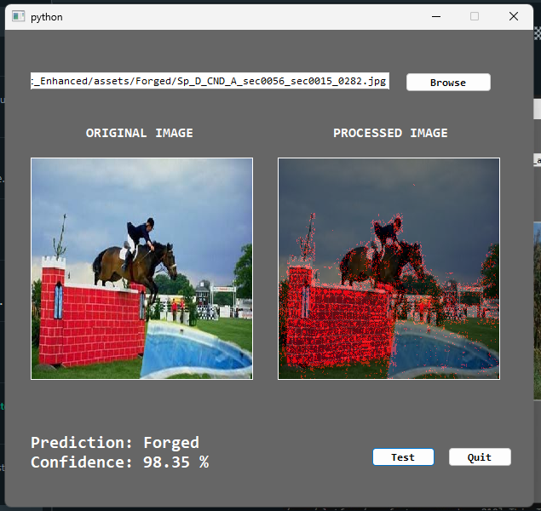
Implementation
Fig. 9: GUI for Image Forgery Detection using ELA (Forged)
14

Slide 22
Conclusion
This project developed an advanced image forgery detection system using Convolutional Neural Networks (CNN) and Error Level Analysis (ELA) to identify pixel-level inconsistencies and compression anomalies in manipulated images. With high accuracy and real-time processing capabilities, the system is scalable and suitable for sectors like journalism, law enforcement, social media, and digital forensics, where image authenticity is critical. Its user-friendly interface ensures accessibility to non-experts. The system provides an effective solution to combat digital misinformation and protect the integrity of visual content in today's digital landscape.
16

Slide 23
References
[1] N. Krishnaraj, B. Sivakumar, R. Kuppusamy, Y. Teekaraman, and A. R. Thelkar, ‘‘Design of automated deep learning-based fusion model for copy-move image forgery detection,’’ Comput. Intell. Neurosci., vol. 2022, pp. 1–13, Jan. 2022.
[2] Y. Abdalla, M. T. Iqbal, and M. Shehata, ‘‘Copy-move forgery detection and localization using a generative adversarial network and convolutional neural-network,’’ Information, vol. 10, no. 9, p. 286, Sep. 2019.
[3] Yaqi Liu, and Xianfeng Zhao, "Constrained Image Splicing Detection and Localization With Attention-Aware Encoder-Decoder and Atrous Convolution" IEEE Access2020.
[4] Yuan Rao, Jiangqun Ni, and Huimin Zhao, "Deep Learning Local Descriptor for Image Splicing Detection and Localization" IEEE Access2020.
[5] Zhang, Y.; Goh, J.; Win, L.L.; Thing, V. Image Region Forgery Detection: A Deep Learning Approach. In Proceedings of the Singapore Cyber-Security Conference (SG-CRC), Singapore, 14–15 January 2016; IOS Press: Singapore, 2016.
[6] Chen, J.; Kang, X.; Liu, Y.; Wang, Z.J. Median Filtering Forensics Based on Convolutional Neural Networks. IEEE Signal Process. Lett. 2015, 22, 1849–1853.
[7] W. Wang, J. Dong, and T. Tan. Exploring dct coefficient quantization effects for local tampering detection. Information Forensics and Security, IEEE Transactions on, 9(10):1653–1666, Oct 2014.
[8] F. Zach, C. Riess, and E. Angelopoulou. Automated image forgery detection through classification of jpeg ghosts. Pattern Recognition, 7476:185–194, January 2012.
3

Slide 24
References
[9] Doegar, A.; Dutta, M.; Gaurav, K. CNN Based Image Forgery Detection Using Pre-trained AlexNet Model. Int. J. Comput. Intell. IoT 2019, 2, 1.
[10] Wu, Y.; Abd-Almageed, W.; Natarajan, P. BusterNet: Detecting Copy-Move Image Forgery with Source/Target Localization. In Proceedings of the European Conference on Computer Vision, Munich, Germany, 8–14 September 2018.
[11] N. Krawetz, "A Picture's Worth... Digital Image Analysis and Forensics," 2007. Accessed: Sep. 28, 2020.
[12] H. Fahmi and W. P. Sari, "Effectiveness of Deep Learning Architecture for Pixel-Based Image Forgery Detection," Apr. 2021, pp. 302-307.
[13] W. Wang and J. Dong, CASIA v1.0, Tampered Image Evaluation Database, Available: http://forensics.idealtest.org/casiav1/, [Accessed: 29-May-2018]
[14] W. Wang and J. Dong, CASIA v2.0, Tampered Image Evaluation Database, Available: http://forensics.idealtest.org/casiav2/, [Accessed: 29-May-2018]
[15] A.C. Gallagher, “Detection of linear and cubic interpolation in jpeg compressed images,” in Proc. 2nd Canadian Conf. Computer and Robot Vision., Victoria, British Columbia, Canada, vol. 171, 2005, pp. 65–72.
[16] H. Farid, “Digital ballistics from jpeg quantization: A followup study,” Dept. Comp. Sci., Dartmouth College, Tech. Rep. TR2008-638, 2008.
3

Slide 25
Thank You !!!
19

Slide 26
Q & A
20

